Slide 1
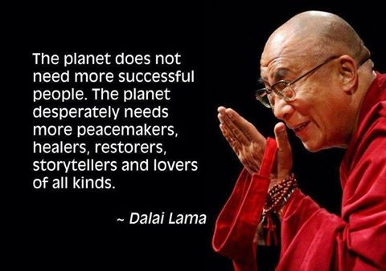
Questions for reflection (Pick 1)
In your view, what moral issues does climate change present to your own faith community? How does science operate in the “solving” of the moral issue that is climate change?
When and why will religious people accord credibility to scientists on the serious issues of our day, like climate change? (draw on the research!)
3. What would Mary Midgely say about what you’ve heard today, the role of science in saving us from changing climate…?
4. Does recognition of being in The Anthropocene (global ecological crisis caused by humans) affect your theology?

Slide 2
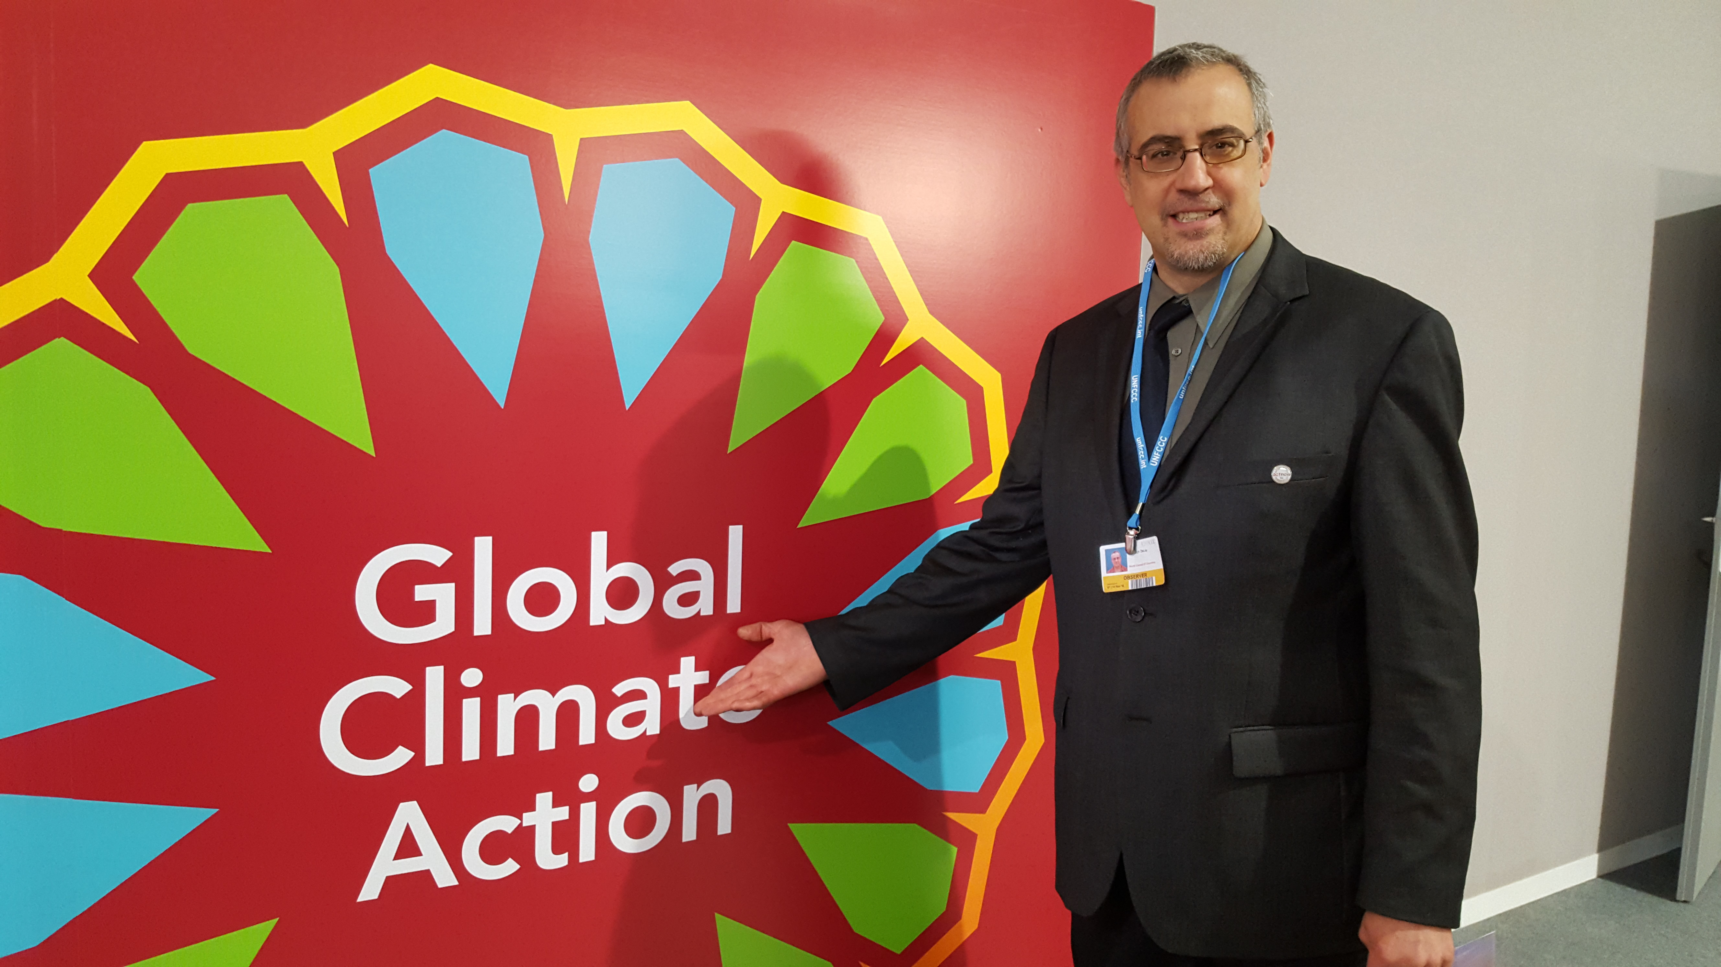
UNFCCC COP22 Marrakech, Morocco November 6-18, 2016

Slide 3
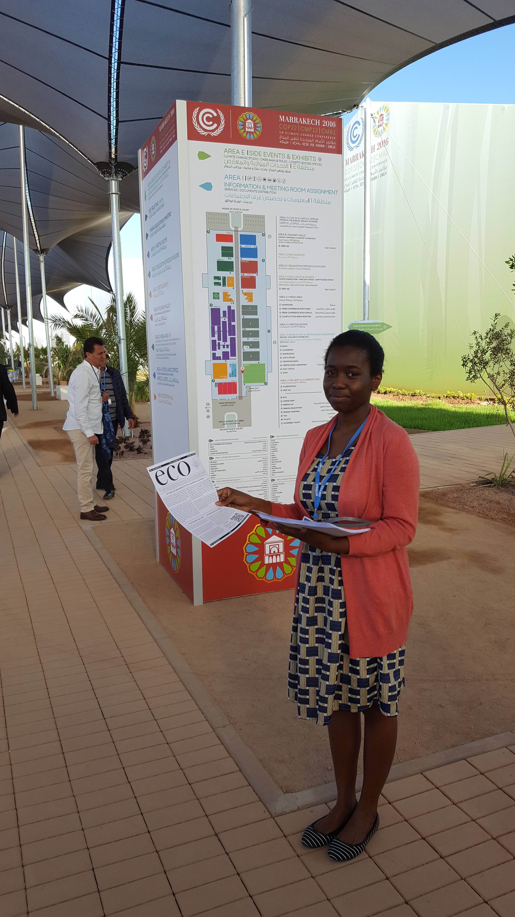
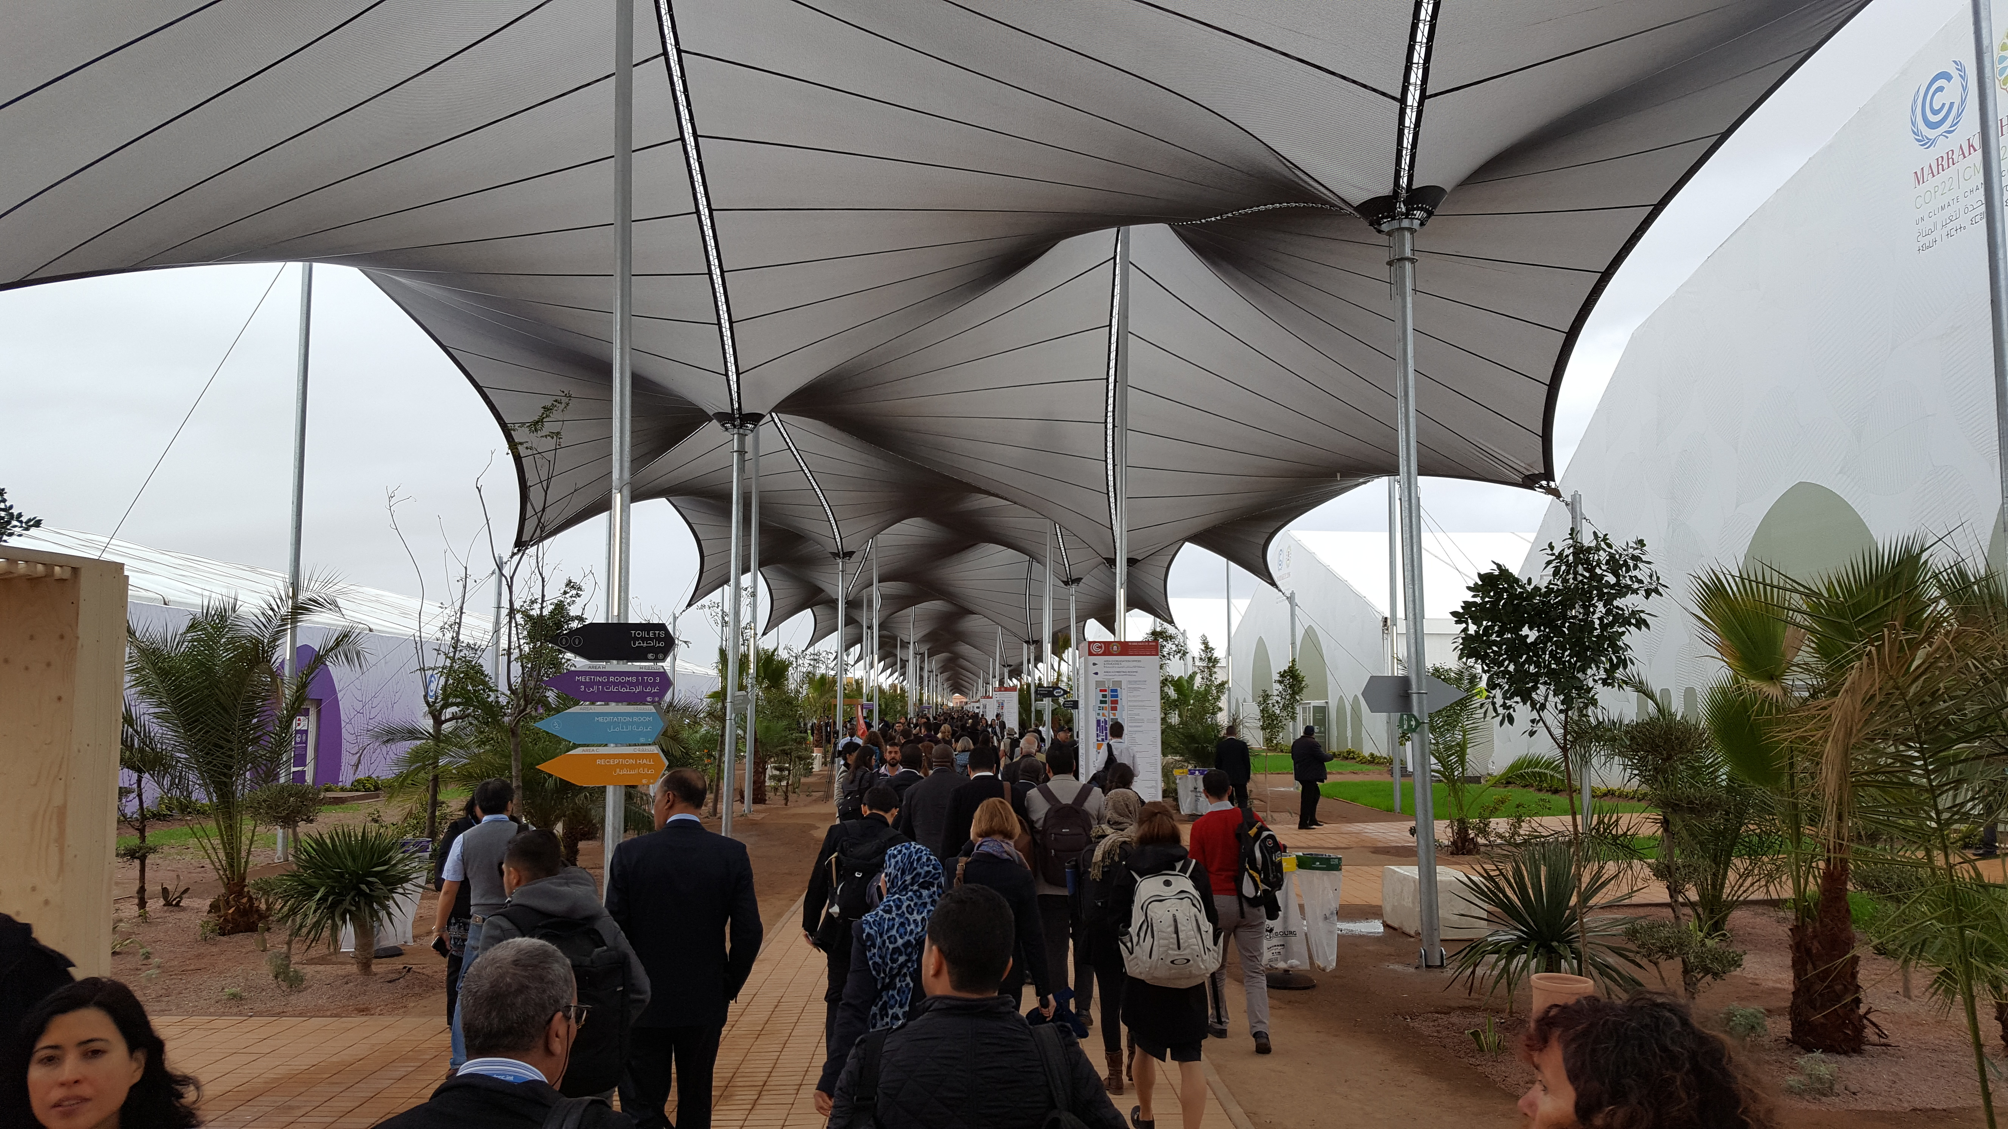

Slide 5
Research

Slide 6
What communicates?
Why denial of climate science?

Slide 7
http://www.bloomberg.com/graphics/2015-whats-warming-the-world/

Slide 8
Climate Change (by the science)

Slide 9
Relig &Climate Change – at odds?
Popular Narrative:
Religious/Christians dispute global climate change
Youtube clip-KH & YoLD?
Better Narrative:
“We are pessimistic, because we pay too much attention to American evangelicals.”
NOT true of Worldwide Evangelicals (WEA)
NOT of other USA Christians (60+%=the majority)
Political ideology more salient variable in almost all studies.
Simplification of “religion” in most studies.

Slide 10
Why this narrative, despite other evidence?
Persistence of conflict narrative
Poor sociological sense of science
E.g., “climate gate”
“global Cooling”
Story of Kari Norgaard
Again, what will overcome denial?

Slide 11
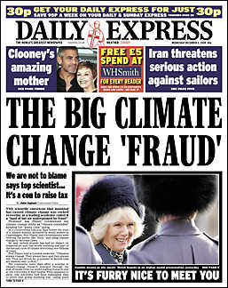
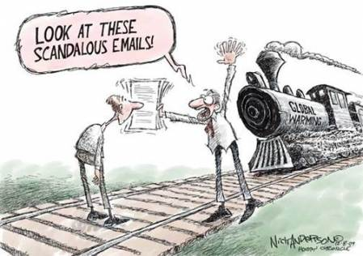
“climate gate”
Hack of emails fr CRU at U of E. Anglia
Right before COP15 (Copenhagen, 2009)

Slide 12
The scandal…
Writing emails as if only the recipient would read it
Using casual terminology
Using scientific jargon that has different meaning in public
“data trick”= cleaning the data
Showing themselves as real (sometimes petty) humans
Acting as if they care (ergo, show “a [vested] interest”) in the results (ergo, use science to make the world better).
Being critical of other scientists (personality, not data)
“keeping out” some science (because person usually does junk sci)
9 investigations exonerate the climate scientists

Slide 13
Global Cooling
Denialists, recently “Scientists once said there was going to be global cooling….”

Slide 14
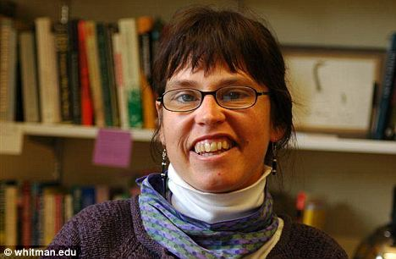
Climate Change and Cultural Inertia (Planet Under Pressure, London (UK), March 2012)
Kari Marie Norgaard, University of Oregon, USA
Robert J. Brulle, Drexel University, USA
Randolph Haluza-DeLay, The Kings University College, Canada

Slide 17
Again-What will overcome denial?
Who are “in denial”?
(note 2 meanings of that!)

Slide 18
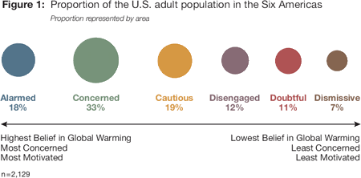
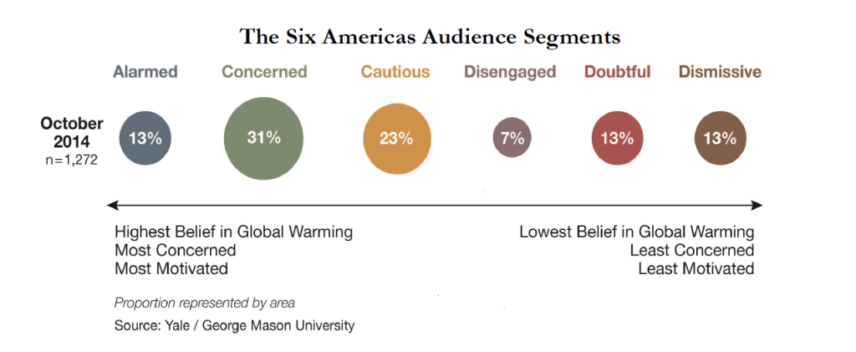
Yale Climate Communication studies- the “Six Americas”
2010
2015

Slide 19
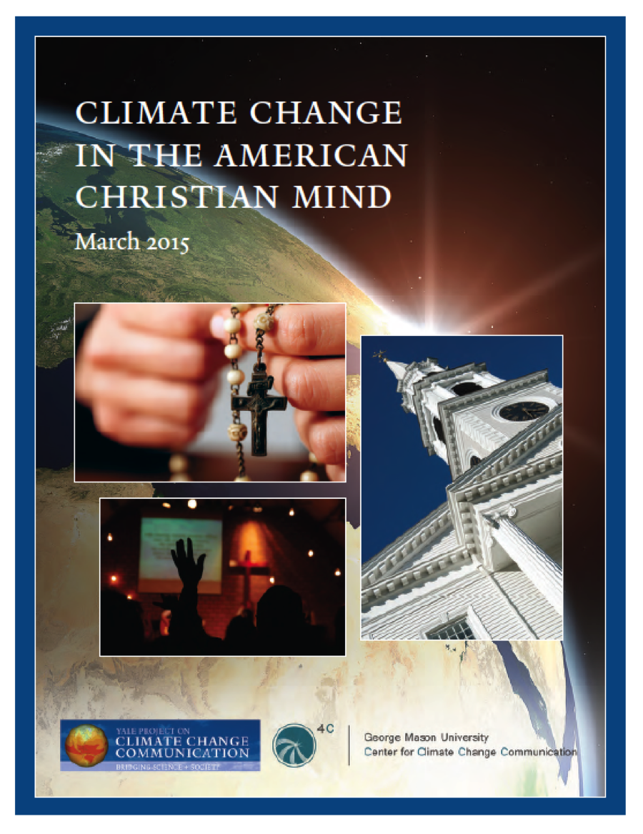
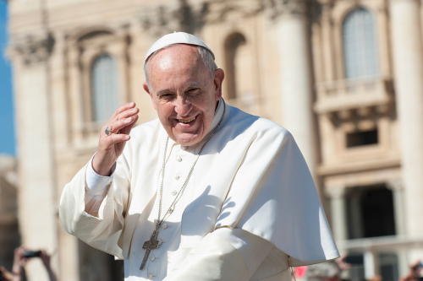
2 Yale Climate Communication Surveys
The Francis Effect: How Pope Francis changed the conversation
about global warming

Slide 20
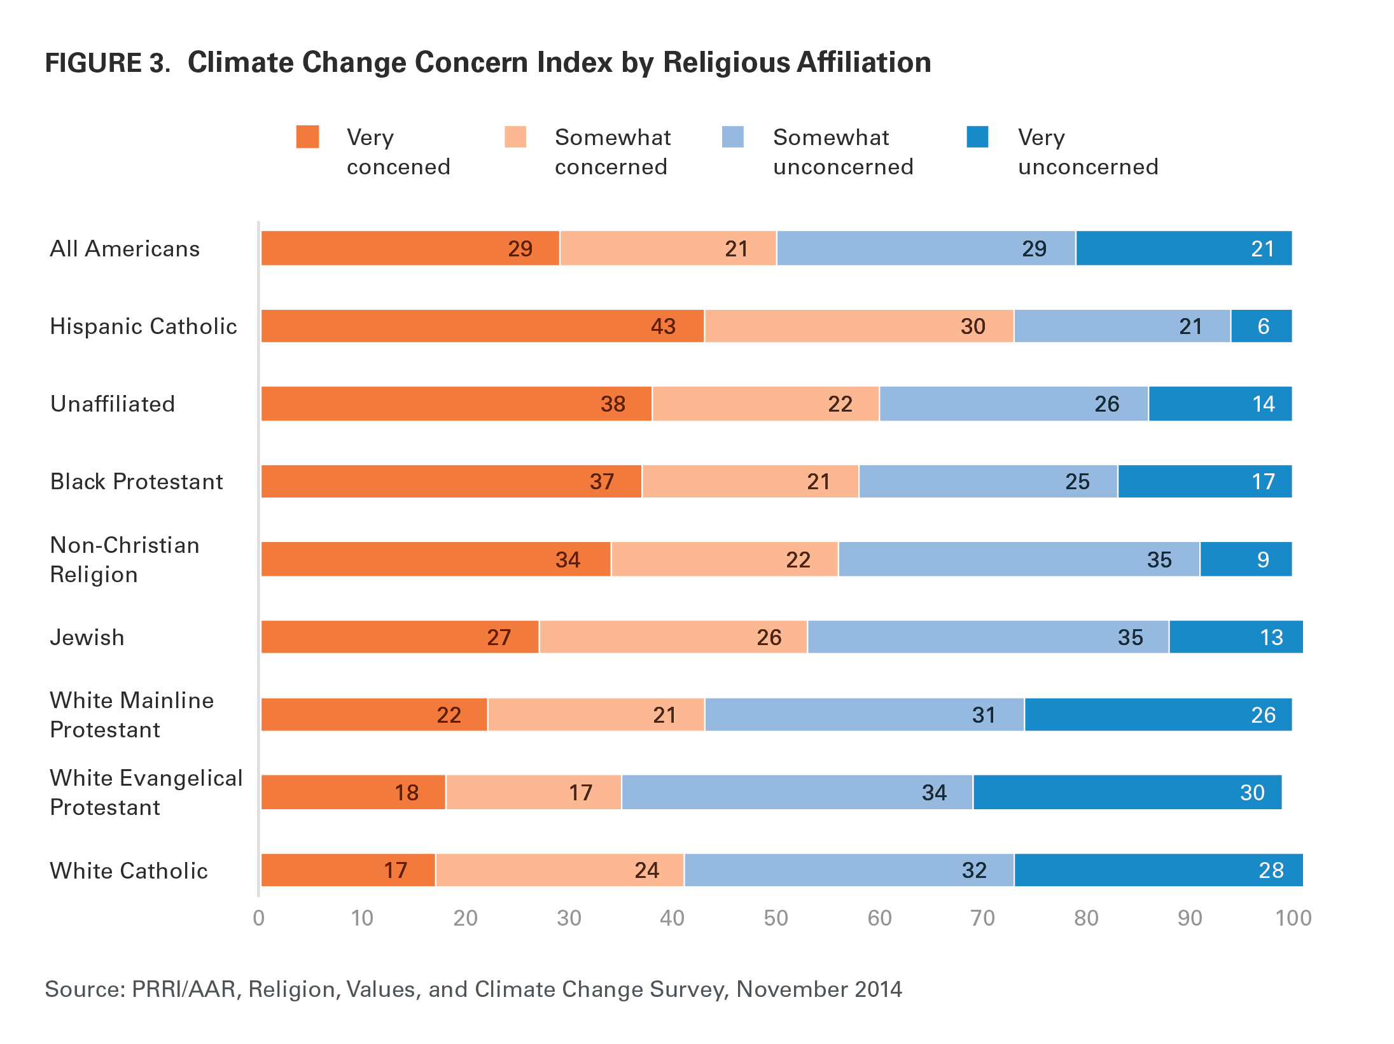
PRRI, 2014

Slide 21
What is a “religion & science” issue?
R& S Mostly about some form of Contested Integration?
Personal experience:
Science as epistemic authority. And Arbitrator.
(Issue of “moral causation”
Bible: 2 Chronicles 7:14; Qur’an: Sura 30:41) - divine agency or Providence
CC does challenge some aspects of religion/theology
Stability of our lives – creation
but “ontological security” for secular folks too. – Norgaard
Omnipotence of the divine (the Creator)
Potency of humanity (the creature is not puny)
Stability of Creation/Nature
implications for character of the Creator?)
Eschatology (apocalyptic, kaliyuga)
Human place/role (hierarchy – superior to rest of Creation)
Ethical implications
“the cancer of the planet”/Goodness of human creativity
Notes:
Corruption has appeared on the land and in the sea because of what the hands of humans have wrought. This is in order that we give them a taste of the consequences of their misdeeds that perhaps they will turn to the path of right guidance. (Qur’an 30:41)

Slide 22
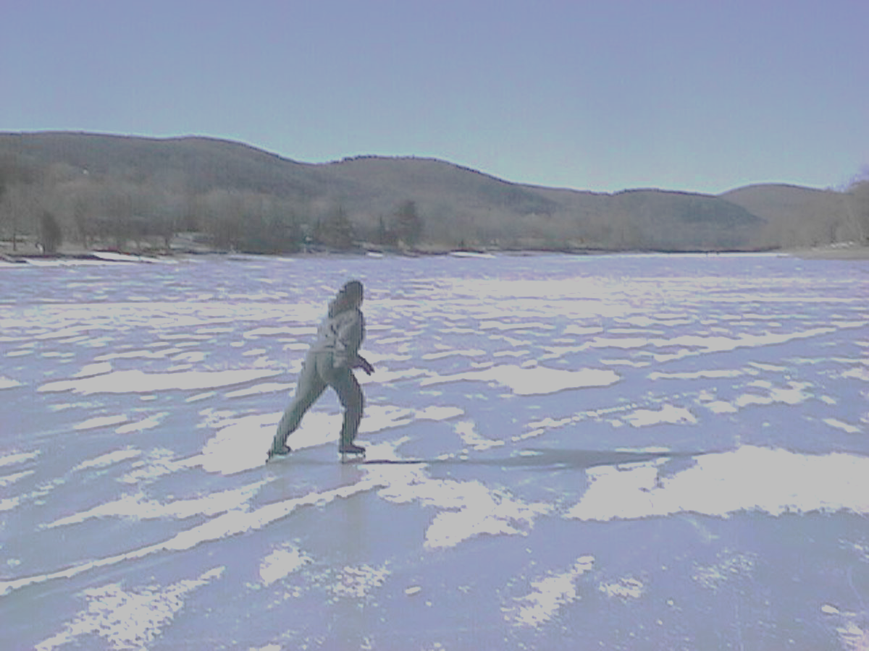
“In Bygdaby the possibility of global warming was both deeply disturbing and almost completely invisible, simultaneously unimaginable and common knowledge.” Norgaard, 2011
Disturbing Emotion | Psychological Principle Operating
Fear of future | Ontological security
Guilt | Identity as a good person
Helplesness | Need for self-efficacy

Slide 23
What is a “religion & science” issue?
R& S Mostly about some form of Contested Integration?
Personal experience:
Science as epistemic authority. And Arbitrator.
(Issue of “moral causation”
Bible: 2 Chronicles 7:14; Qur’an: Sura 30:41) - divine agency or Providence
CC does challenge some aspects of religion/theology
Stability of our lives – creation
but “ontological security” for secular folks too. – Norgaard
Omnipotence of the divine (the Creator)
Potency of humanity (the creature is not puny)
Stability of Creation/Nature
implications for character of the Creator?)
Eschatology (apocalyptic, kaliyuga)
Human place/role (hierarchy – superior to rest of Creation)
Ethical implications
“the cancer of the planet”/Goodness of human creativity
Notes:
Corruption has appeared on the land and in the sea because of what the hands of humans have wrought. This is in order that we give them a taste of the consequences of their misdeeds that perhaps they will turn to the path of right guidance. (Qur’an 30:41)

Slide 24
When and why will religious people accord credibility to scientists?
What can we learn from the following research?
Study by Brulle, Carmichael & Jenkins (2012)
Study by Gauchat (2015)
3 studies (unpublished) by King’s faculty (RHD & Willson) and undergrads (Ashley Fischer, Elisa Benterud)

Slide 27
What drives these changes in public opinion?
Hypotheses:
Extreme Weather events?
Scientific information?
Amt of Media coverage?
Environmental Advocacy (reported in mass media)?
Elite political cues (stmts from your party one believes)?

Slide 28
Does public opinion follow….?
Hypotheses:
Extreme Weather events?
Scientific information?
Amt of Media coverage? - YES
Environmental Advocacy (reported in mass media)?
Elite political cues (stmts from the party one believes)? – YES, YES, YES.

Slide 29
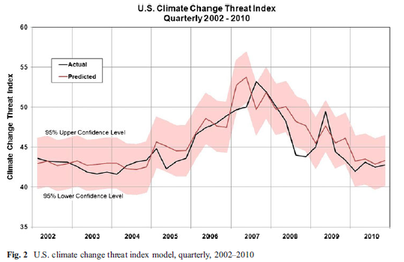

Slide 31
Can people “trust” science? (PUS)
Three explanations why people don’t “understand” science
Deficit model- knowledge is lacking
increasing scientific literacy will help people understand
Schemes of interpretation - social & cultural factors (group membership, media framing, affect, political ideology) impact understanding
However, this model eventually concludes that sociocultural factors are critical only bec of the lack of requisite knowledge and information
Ignores most research in science education that people construct their understandings in the interplay of past understandings and current learning (Piaget – processes of accommodation and assimiliation)
Public perceptions of science are formed in a field of relationships between the individual and social environment that include discursive claims about the cultural image of science.
For example, if religious authorities say scientists are enemies of faith…
For example, if political affiliations say scientists are lying…
Any of these three explanations can be part of polarization on issues of science (climate, stem cells, etc)

Slide 32
Studied tested 3 hypotheses for “polarization”
left-right polarization along a single latent dimension (i.e., liberal-conservative views).
conflict between traditional (religious) and secular worldviews (known as the “culture wars” in US) context
polarization is multidimensional and dynamic.

Slide 33
Gauchat-conclusions
Not simple:
Not left/right or traditional/secular
People with good understandings of science often more deeply entrenched their polarization.
Therefore, 3. and C were most accurate:
C: “polarization is multidimensional and dynamic”
3. the cultural image of science matters most in people’s trust levels, and the cultural image is based on social group affiliation and authorities.
In other words, trust is “science” is a matter of legitimization (a process) of “epistemic authority” and not a matter of literacy, or

Slide 34
Climate Change, Science, and Faith
Three Studies:
SCIO Visiting Scholar in Science and Religion, associated with Wycliffe Hall in Oxford, UK
SI: Edmontonians Talk about Faith, Science, & Climate Change
Edmonton Interfaith Centre
Ashley Fischer & Randolph Haluza-DeLay
Interviews
S2: What’s in Faith-based Climate Statements?
Randolph Haluza-DeLay & Elisa Benterud
Content analysis
Intl Society for Study of Religion, Culture & Nature
S3: Climate Communication Efficacy – survey of students @ The King’s U
Randolph Haluza-DeLay, Leanne Wilson, Katherine Hayhoe, Doug Hayoe
Survey

Slide 35
Questions for reflection (Pick 1)
In your view, what moral issues does climate change present to your own faith community? How does science operate in the “solving” of the moral issue that is climate change?
When and why will religious people accord credibility to scientists on the serious issues of our day, like climate change? (draw on the research!)
3. What would Mary Midgely say about what you’ve heard today, the role of science in saving us from changing climate…?
4. Does recognition of being in The Anthropocene (global ecological crisis caused by humans) affect your theology?

Slide 36
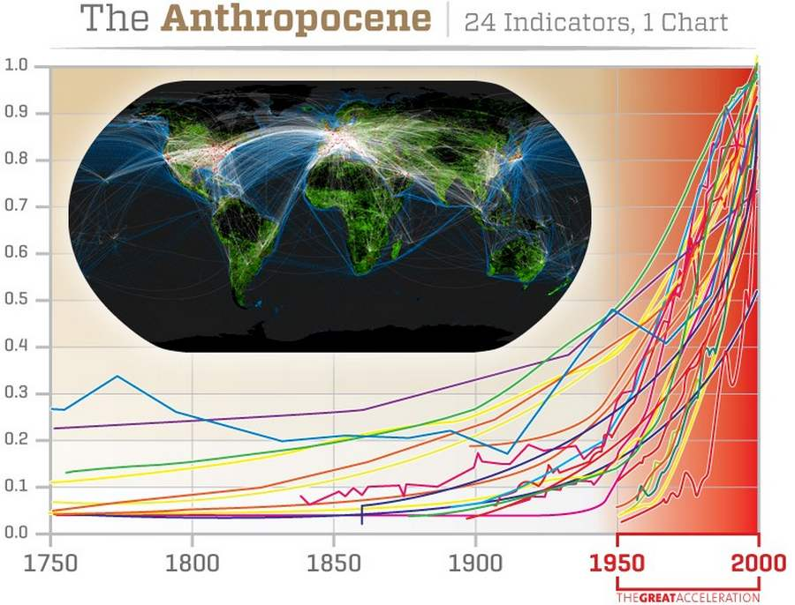
The Anthropocene
Global-scale declining ecological conditions (mostly human-causation). From paper published in 2004, updated 2013 by Will Steffen (ref available upon request!)

Slide 37
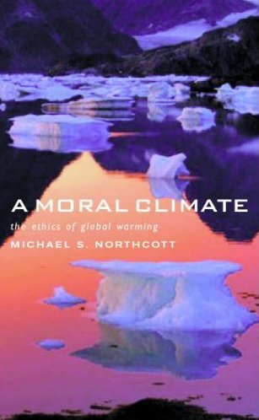
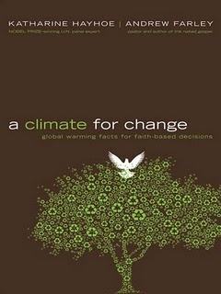
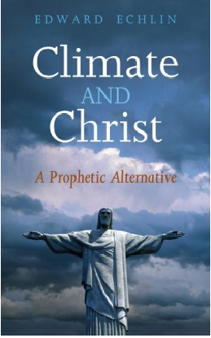
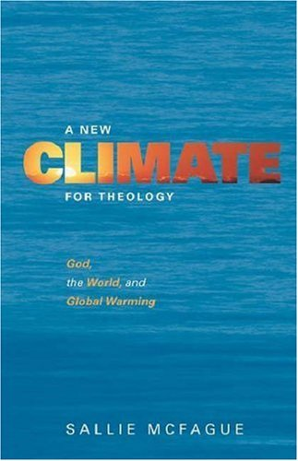
Examples of Cosmological Attention to CC:
Notes:
Massive literature searches.
Results – mostly Christians, although I do emphasize the possibility of a language bias (English). Resource biases.
SOCIAL SCIENTIFICALLY, this worldviews impact is one possible venue for change, and for study – how are these FRAMING different ways of thinking? Especially in light of the apocalypticism represented in the previous comic about the ways science is presenting the Climate Crisis, Climate Catastrophe?
With that in mind, I have a requested essay for Nature & Culture on “An Environmental Sociologist Reads CC Theology”, conceptualizing theological expressions as a form of “framing” as in social movements.
What is difficult to know is how these theological expressions, or the many statements made by various religions bodies, affect the lived practice – religiously or eco-socially – of adherents. If nothing else, it is important that the discourse be in the wind, although I also know that many studies indicate that adherents of must faiths do not hear much about CC in their collective gatherings – churches, temples, etc.
At the same time, analysis of these expressions and their diagnoses and prognoses matter – Christians for example have often framed things around “justice” and name “sin” as a key cause, while Buddhism will name “ignorance” (of the illusory nature of the world) and project solutions in terms of detachment and compassion (Stanley, et al, 2009).

